Slide 1





CAFE MANAGEMENT SYSTEM FOR ‘GULUZ CAFE’
BY: Jubisha Prajapati

Slide 2
TABLE OF CONTENTS
01
05
02
03
04
Introduction
Tools used
Introduction to Organization
06
Use Case Diagram
Demo Video
Problem Statement
07
Objectives
Conclusion
08

Slide 3
INTRODUCTION
Cafe Management System is a desktop-based application.
It offers a user-friendly interface for handling billing, tracking sales transactions, automating record-keeping, monitoring account receivables and managing customer and employee information.

Slide 4

INTRODUCTION TO ORGANIZATION
Name of the organization: Guluz Cafe
Location: Chhauni, Kathmandu
Established: 2023 A.D.
Owners: Bishal Prajapati and Shreejal Shrestha

Slide 5
PROBLEM STATEMENT
The lack of a proficient billing system poses a hindrance to effectively monitoring the sales.
The reliance on manual record- keeping poses a significant risk of losing important information including customer information, sales details, employee details and order history.

Slide 6
OBJECTIVES
To provide a desktop-based software system for managing orders and bills.
To provide easy access to customer management, employee management and sales reports.

Slide 7
TOOLS USED
Tools/ Framework | Purpose
Java Swing GUI | Frontend
Java | Backend
MySQL | Database
XAMPP | Server implementation
NetBeans | IDE
JasperReports | Report Designing

Slide 8
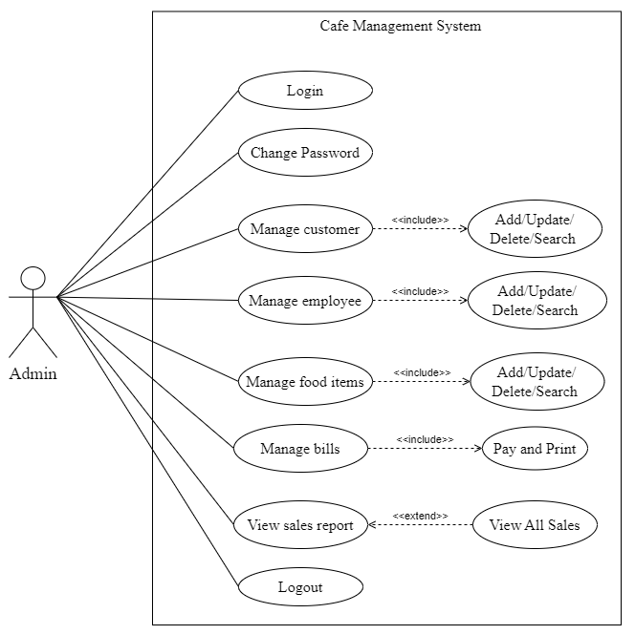
USE CASE DIAGRAM

Slide 9
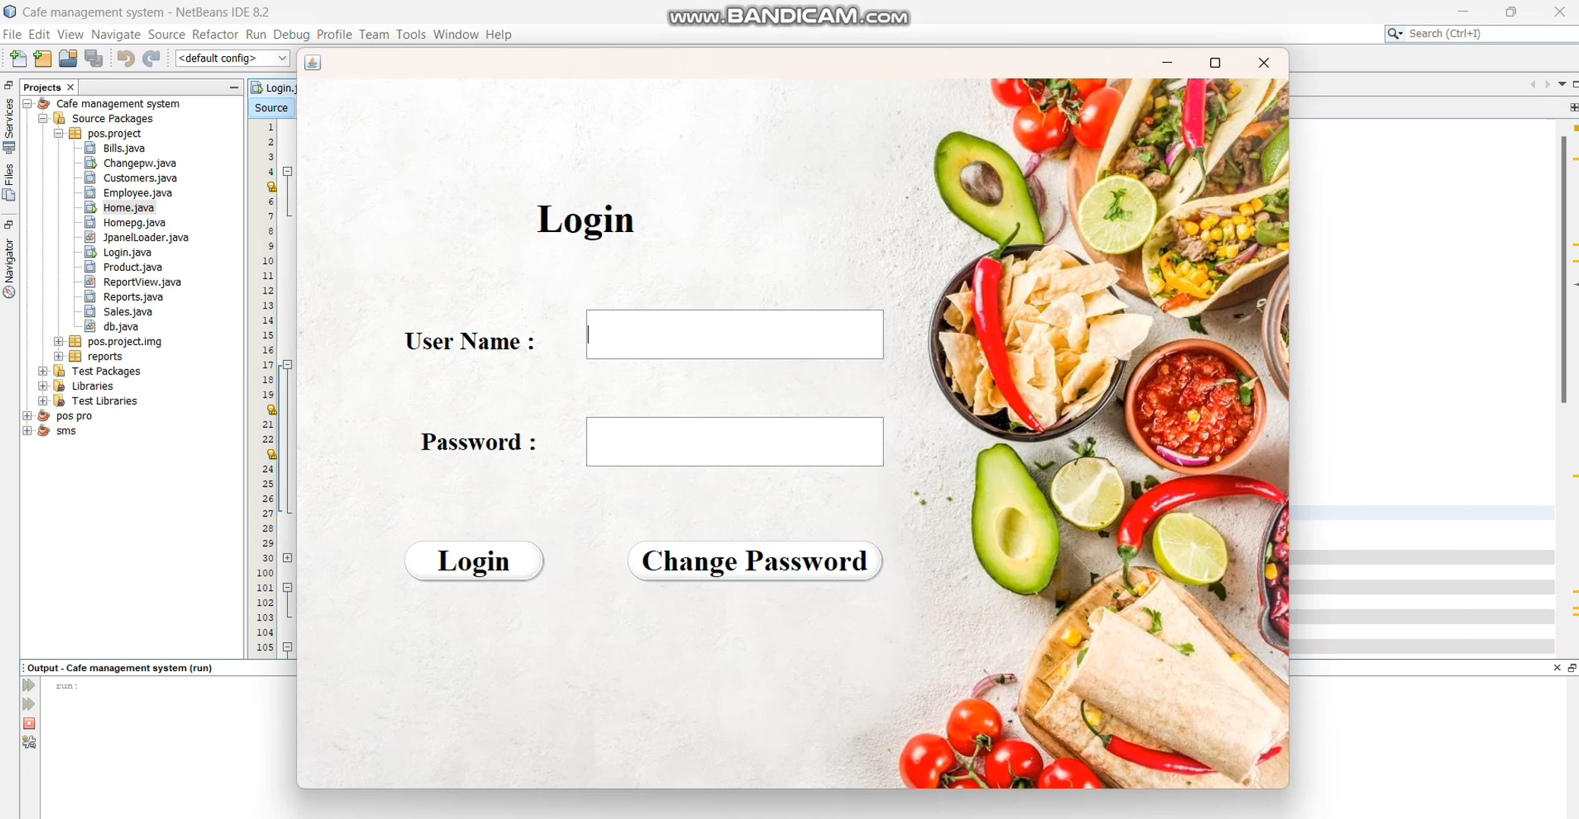

Slide 10
CONCLUSION
In conclusion, the adaptation of “Cafe Management System” for Guluz cafe is tailored to meet specific needs of the cafe, offering functionality for monitoring and tracking of sales transactions, maintenance of regular customer and employee’s information, managing food orders and billing features.

